Slide 1

Statistical Analysis of Hotel booking demand
By:
Carlos Daniel Leobardo Marcelo

Slide 2

Motivation & Summary
Perform an Exploratory Data Analysis (EDA) of two different hotels. (city and beach)
Appling a data analysis to gain insight on Bussines that is unknown for all the team members.
Learn to use visualization to answer business-related questions.
Look for factors that causes cancelation

Slide 3

Questions & Data
Where do the guests come from?
Which month have the highest number of cancelations?
How many bookings were canceled
Bookings by market segment
Which are the busiest month?
How much do guests pay for a room per night?
How does the price per night vary over the year?
How long do people stay at the hotels?

Slide 4

Data Cleanup & Exploration
Our cleaning process: Remove NA Most of the data was clean
Problems experienced: We had to filter the data using different columns using panda functions like “loc. “, “usecols” and “fillna” “isnull”
Set Goals and Create a Plan: We created and stater book with clean data, and then each team member worked on a separate question, and we merged everything at the end.

Slide 5
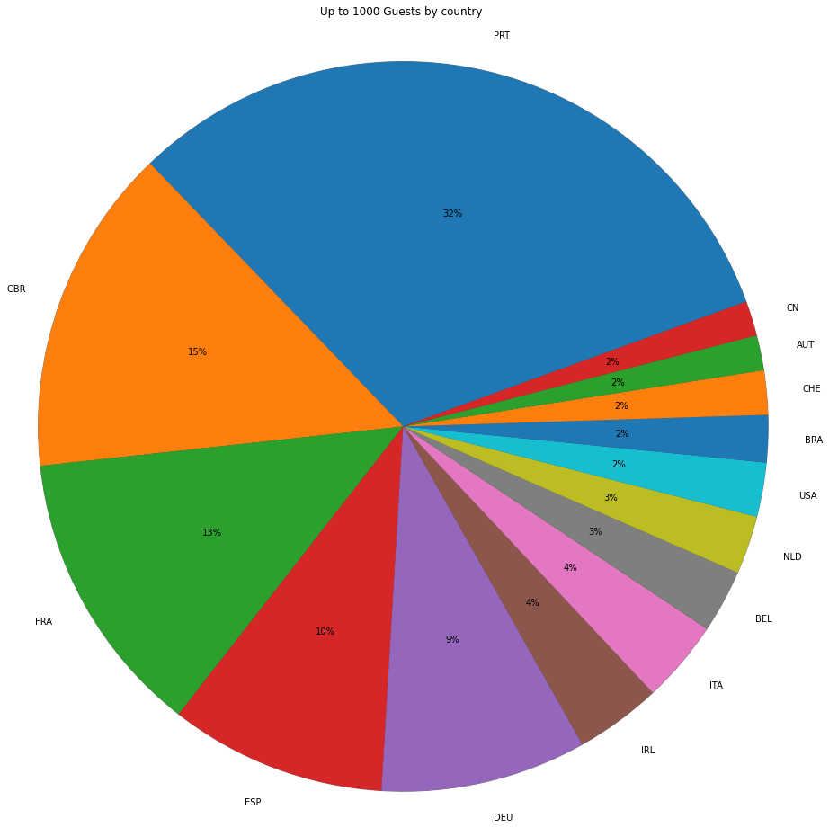
Where do the guests come from?
To answer this question the data was filtered by a registered country and a confirmed reservation
For presentation reasons up to 1000 guest per country were considered for the second pie plot and Map
After the analysis the mayor percentage (28%) of guests came from Portugal, which make sense as the data provides information from that specific country.
An interesting fact is that the second country with the highest percentage of guests (13%) is Great Britain despite the distance
Another interesting fact is that although Spain is very close, it is the country with the fourth percentage of guests (9%)

Slide 6
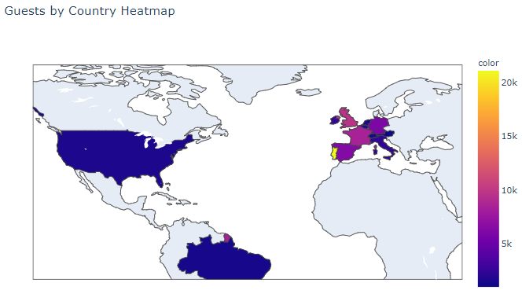
Where do the guests come from?

Slide 7
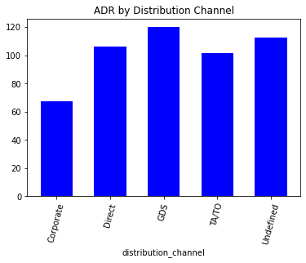
Most of the reservations (76.79%) came through Travel agents and Tour operators followed by Direct reservation to the Hotels. On average the Cost of the Daily rate is higher when reservations area made using a Global Distribution System (GDS) and we have the lower rates for Corporate clientes. -Travel Agencies have the second lowest rate.
How much do guests pay for a room per night?

Slide 8
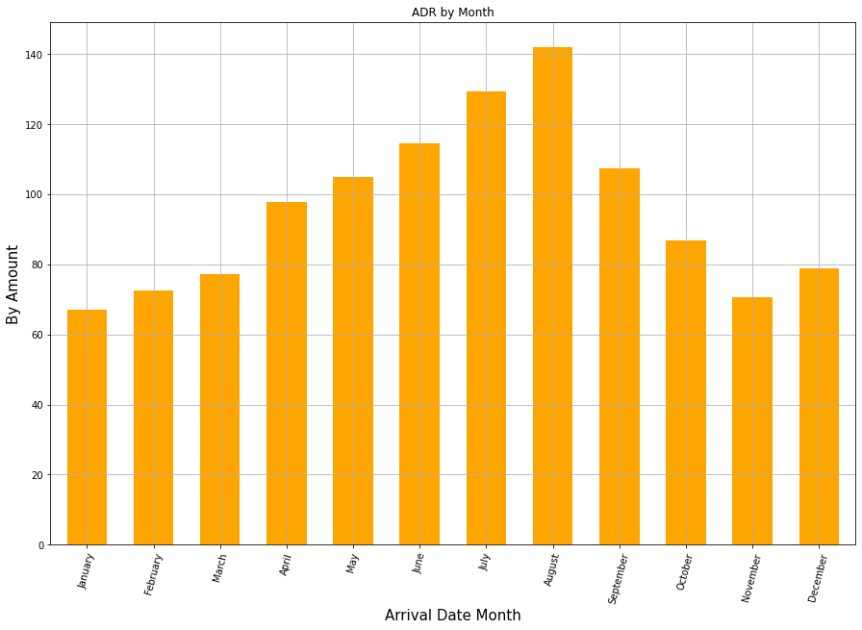
How does the price per night vary over the year?
The summer months are the most expensive and the winter months are the most affordable

Slide 9
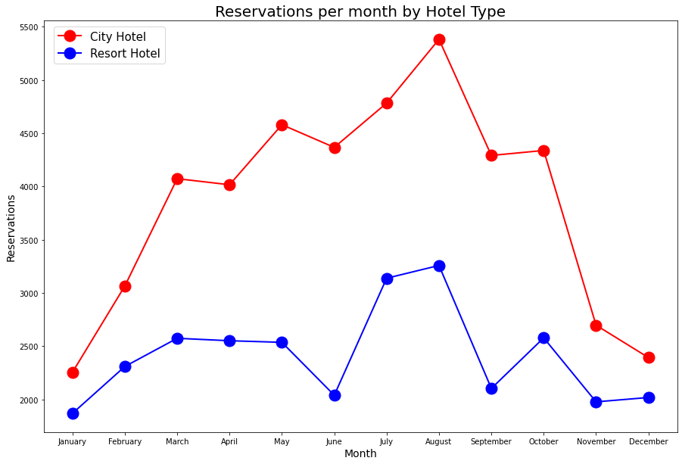
Which are the busiest month?
The busiest month for both Hotels is August and we can consider November-January being low season where demand drops considerable to the rest of the year.

Slide 10
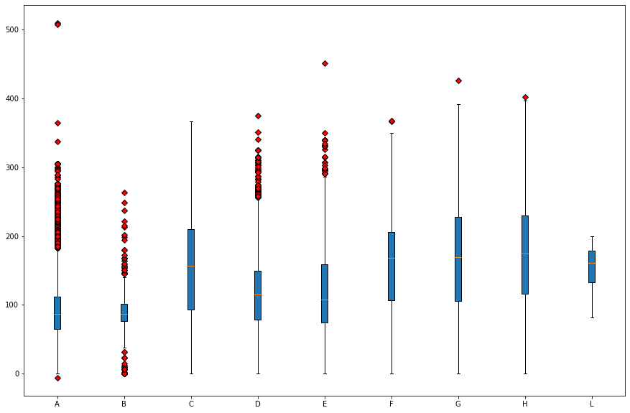
What is the average price by room type?
The room types represent the size and meal arrangements, even though they may not be the same for each Hotel and price varies depending demand.
Rooms A and B had the lowest average price per room while rooms G and H had the highest average price.
This plot was filtered by Guest with the following criteria
Who didn't cancel reservation
That has a registered country
More than 1000 per country

Slide 11
Which is the busiest month?
The busiest month for both Hotels is August
We can consider November-January being low season where demand drops considerable to the rest of the year.
This plot was filtered by number of reservations per Month
Only not canceled reservations were included

Slide 12
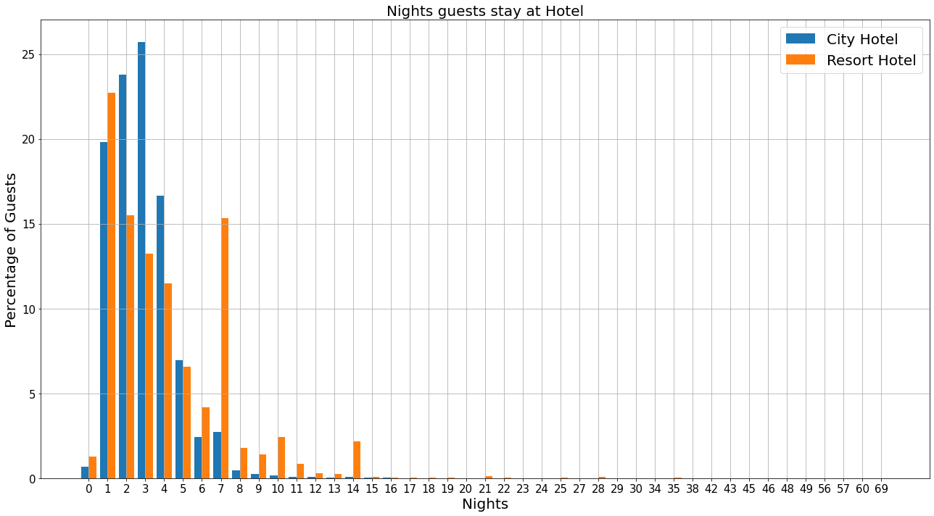
How long do people stay at the hotels?
Filtered by City Hotel, Resort Hotel, and a confirmed reservation.
From analysis, average nights that a guest stays in a City Hotel is 2.92 nights and 52 is the maximum number of nights that a guest has stayed in the City Hotel.
At the Resort Hotel is 4.142892 and 69 is the maximum number of nights a guest has stayed in the Resort Hotel
The 25.73 % of guests stayed 3 nights at a City Hotel, which is considered the biggest percentage
The 22.73 % of guests stayed 1 night at a Resort Hotel, which is considered the biggest percentage

Slide 13
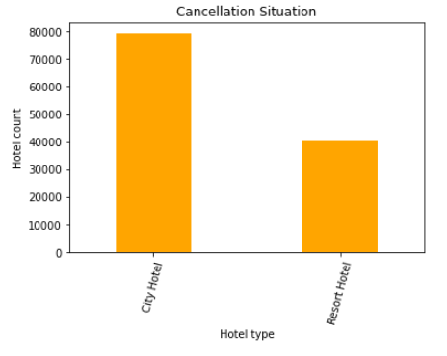
How many bookings were canceled?
City Hotels has the highest cancelation rate
37,04% of the total bookings were canceled

Slide 14
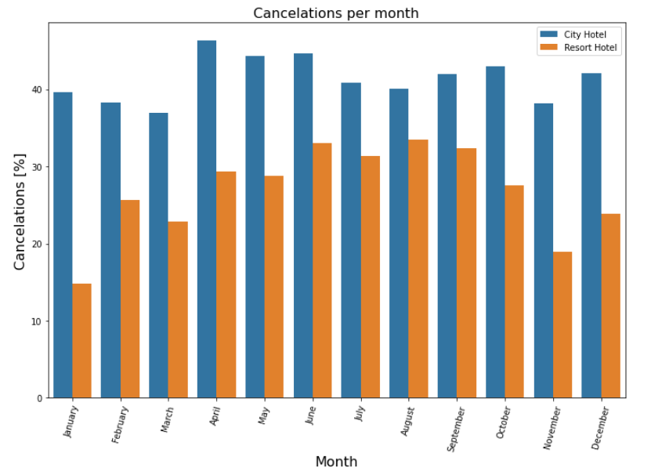
Which month have the highest number of cancelations?
August is the month with more cancelations (11.85%) and January is the month with less cancelations (4.09%)
For city hotels there is not much variance between months For the Resort hotel it is highest cancelations in the summer and lowest during the winter

Slide 15
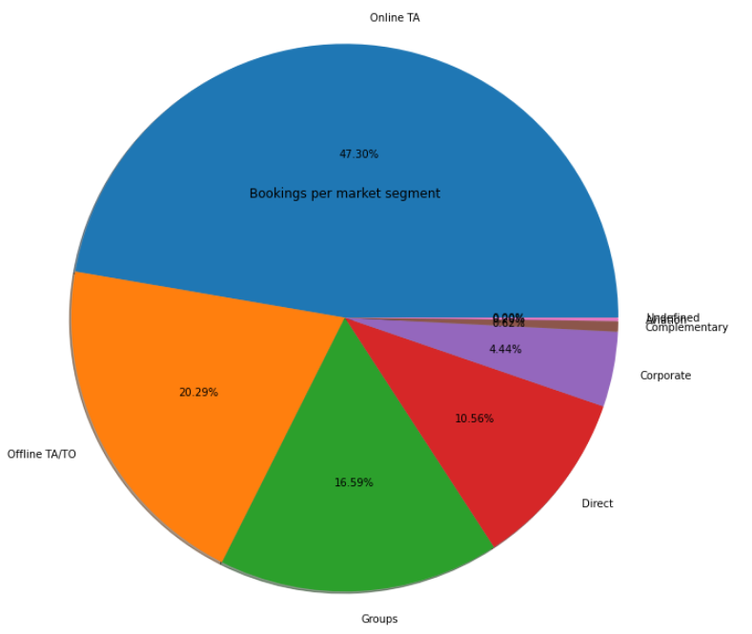
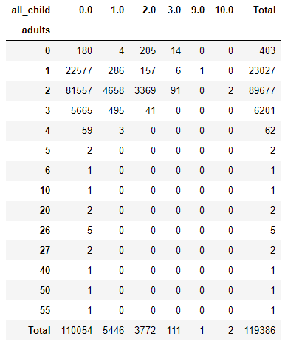
Bookings by market segment
Adults without children = 110,054 Adults with 1 child = 5446 Adults with 2 children = 3772 Adults with 3 children = 111.
From the above table we can deduce that of the 119 thousand reservations, 110,054 were reservations for without children, most of them couples, followed by people traveling alone.
When there are more bookings with children, two adults travel, we can deduce that they are couples and their children
47.30% of bookings were made online, 20.29% offline.
The rest were made by groups, corporations, directly at the hotel or by airline packages

Slide 16
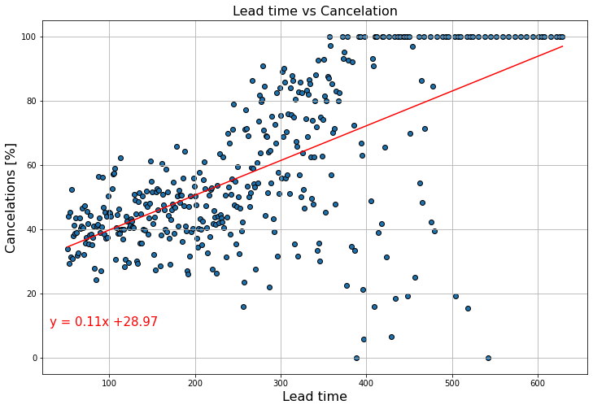
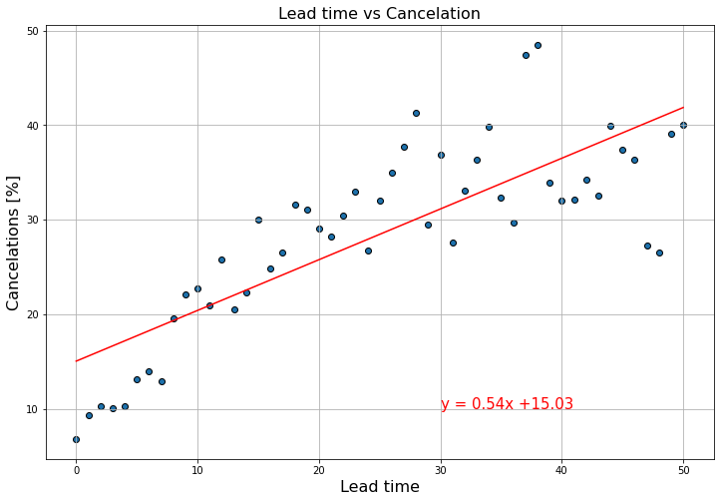
Is there a correlation between Cancelations and Lead time?
After analyzing the data, we decided to separate it in two groups, the first one takes into account the lead time for reservations under or equal to 50 days and the second one over 50 days.
For the lead time under or equal to 50 we found that the average of cancellation was 28.45% and the r-value was 0.6482313461494058
For the lead time over 50 we found that the average of cancellation was 56.28% and the r-value was 0.3919649481639411
We can observe that reservations with lead time over 50 days are twice as likely to be cancelled.

Slide 17

Any Questions?
Thank you

